Slide 1

Motivation
Power output $P$ of a tokamak
$$P∝n_{T}⋅n_{D}⋅T$$
where:
$n_{T}$ is tritium density in the core;
$n_{D}$ is deuterium density in the core;
$T$ is temperature.

Slide 2
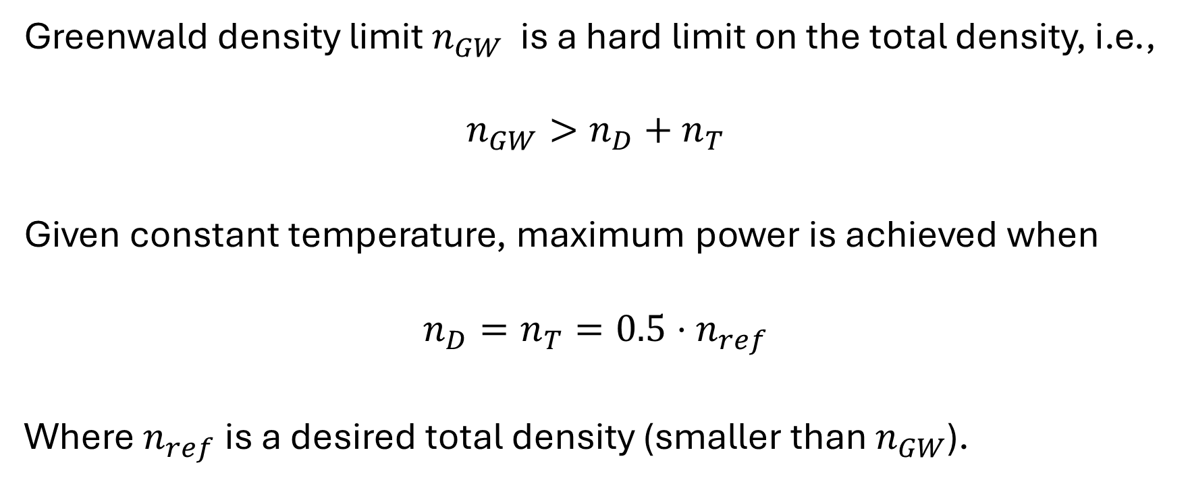
Motivation
Greenwald density limit $n_{GW}$ is a hard limit on the total density, i.e.,
$$n_{GW}>n_{D}+n_{T}$$
Given constant temperature, maximum power is achieved when
$$n_{D}=n_{T}=0.5⋅n_{ref}$$
Where $n_{ref}$ is a desired total density (smaller than $n_{GW}$).

Slide 3

Motivation
Goal
Achieve $n_{D}=n_{T}=0.5⋅n_{ref}$
Problem
Densities decay over time
$${\dot{n}}_{D}=−α_{1}n_{D}$$
$${\dot{n}}_{T}=−α_{2}n_{T}$$

Slide 4

Motivation
Goal
Achieve $n_{D}=n_{T}=0.5⋅n_{ref}$
Problem
Densities decay over time
$${\dot{n}}_{D}=−α_{1}n_{D}+Γ_{D}$$
$${\dot{n}}_{T}=−α_{2}n_{T}+Γ_{T}$$
We can control the flowrates $Γ_{D}$ and $Γ_{T}$

Slide 5

Motivation
Goal
Achieve $n_{D}=n_{T}=0.5⋅n_{ref}$
Problem
The fuel ratio is defined as
$$r=\frac{Γ_{T}}{Γ_{T}+Γ_{D}}$$

Slide 6
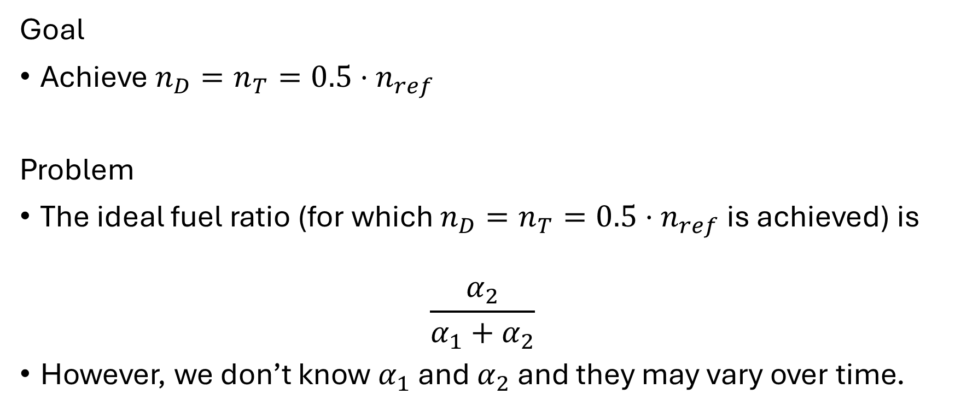
Motivation
Goal
Achieve $n_{D}=n_{T}=0.5⋅n_{ref}$
Problem
The ideal fuel ratio (for which $n_{D}=n_{T}=0.5⋅n_{ref}$ is achieved) is
$$\frac{α_{2}}{α_{1}+α_{2}}$$
However, we don’t know $α_{1}$ and $α_{2}$ and they may vary over time.

Slide 7
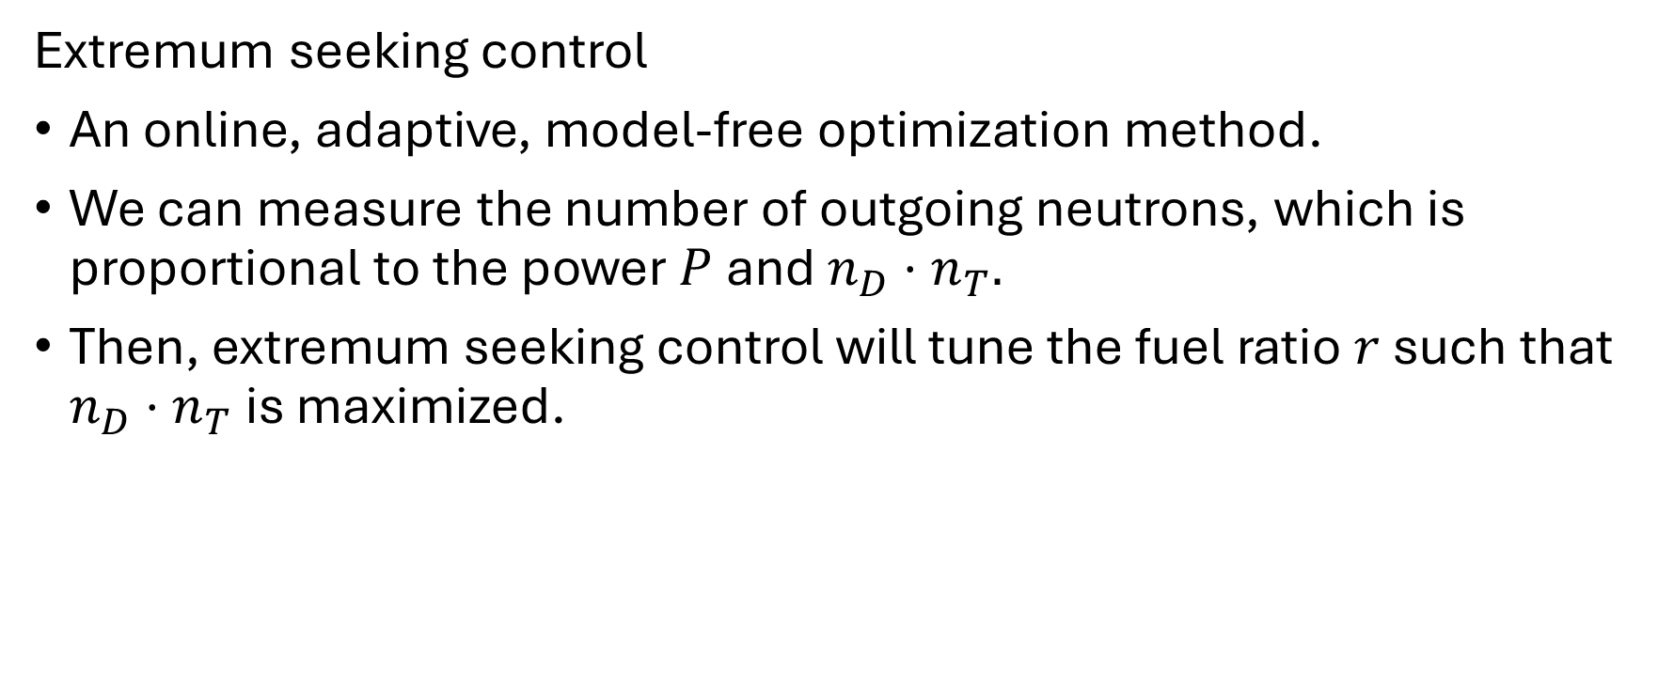
Solution
Extremum seeking control
An online, adaptive, model-free optimization method.
We can measure the number of outgoing neutrons, which is proportional to the power $P$ and $n_{D}⋅n_{T}.$
Then, extremum seeking control will tune the fuel ratio $r$ such that $n_{D}⋅n_{T}$ is maximized.

Slide 8
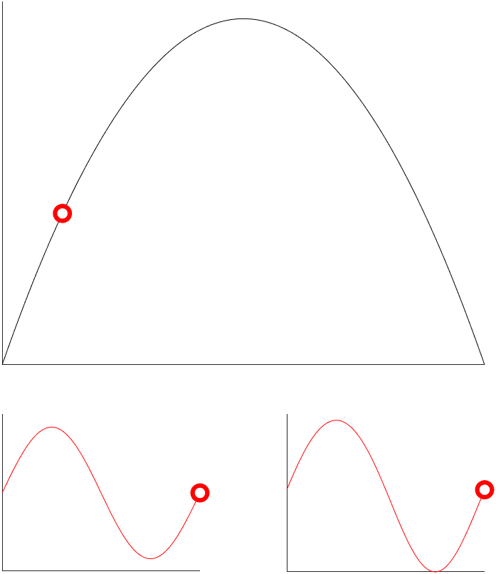

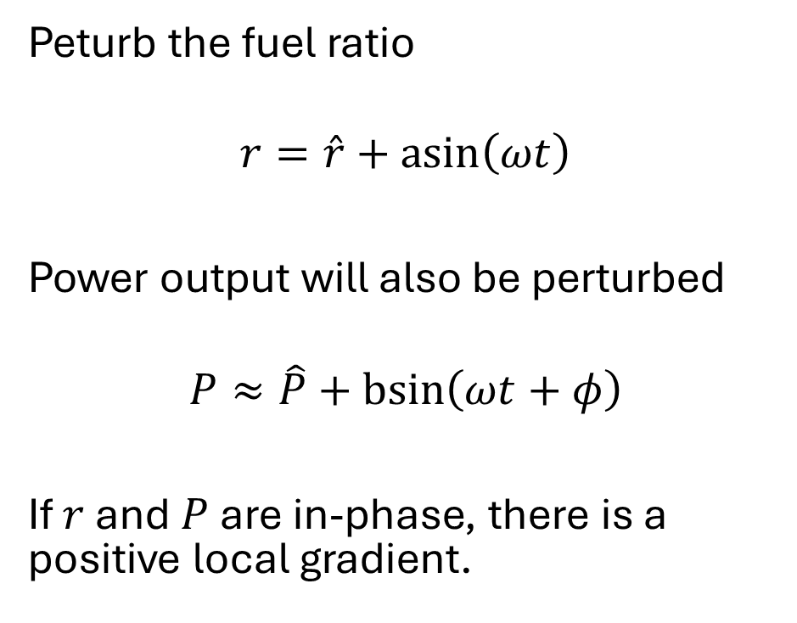





Extremum seeking control
Peturb the fuel ratio
$$r=\hat{r}+\operatorname{asin}\left(ωt\right)$$
Power output will also be perturbed
$$P≈\hat{P}+\operatorname{bsin}\left(ωt+φ\right)$$
If $r$ and $P$ are in-phase, there is a positive local gradient.
$$P$$
$$r$$
$$r$$
$$P$$
$$t$$
$$t$$

Slide 9
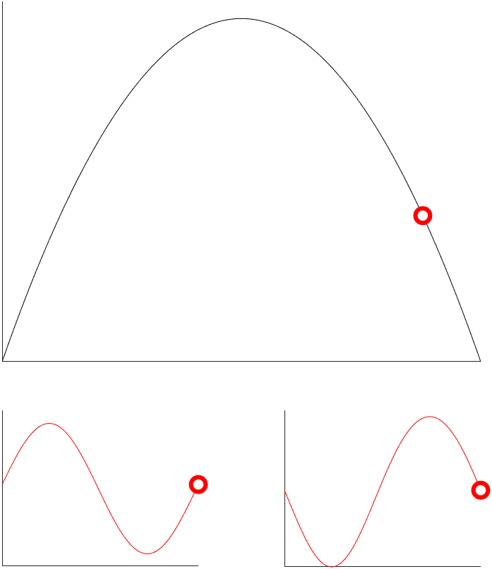
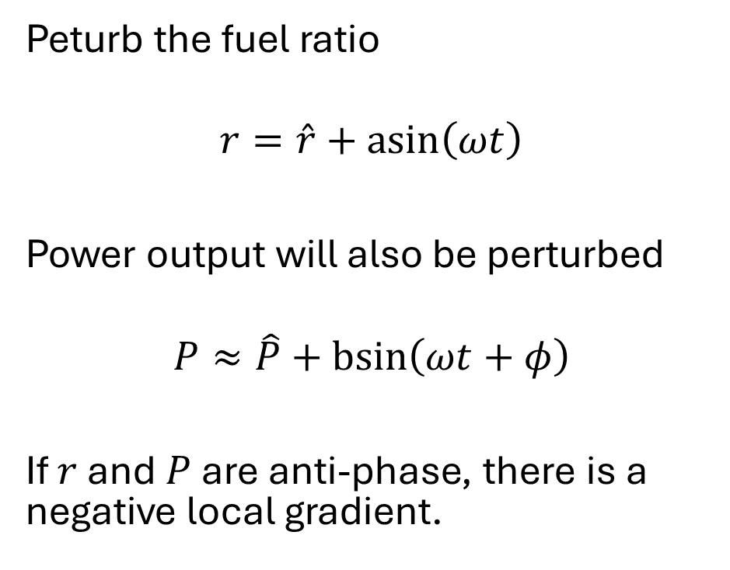
Extremum seeking control
Peturb the fuel ratio
$$r=\hat{r}+\operatorname{asin}\left(ωt\right)$$
Power output will also be perturbed
$$P≈\hat{P}+\operatorname{bsin}\left(ωt+φ\right)$$
If $r$ and $P$ are anti-phase, there is a negative local gradient.
$$P$$
$$r$$
$$r$$
$$P$$
$$t$$
$$t$$

Slide 10
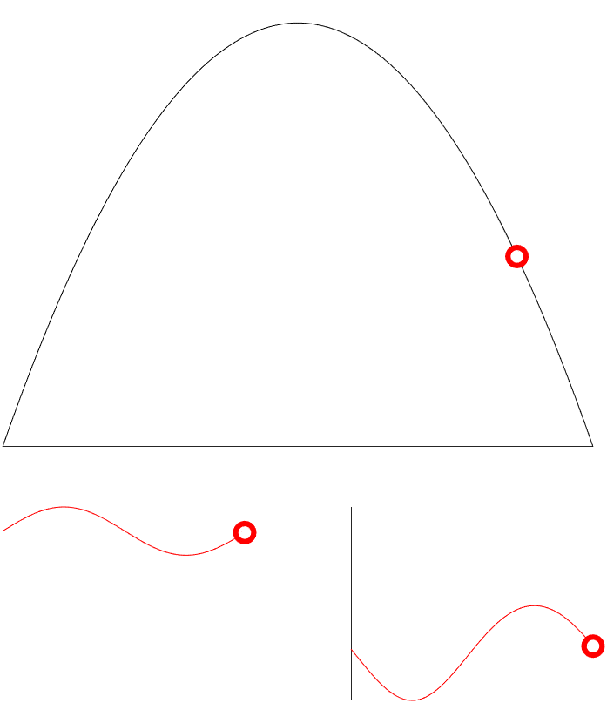
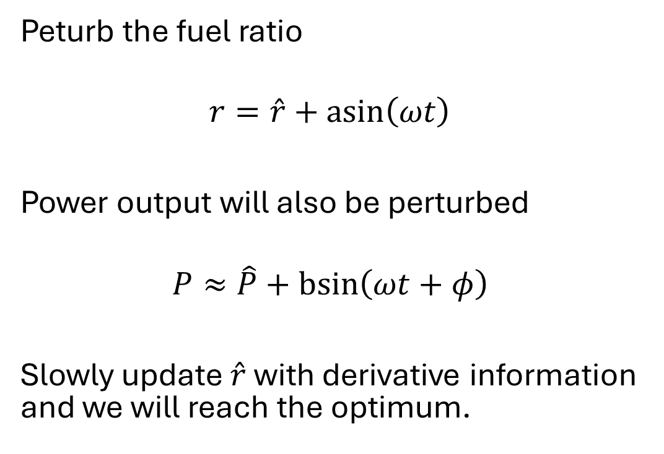
Extremum seeking control
Peturb the fuel ratio
$$r=\hat{r}+\operatorname{asin}\left(ωt\right)$$
Power output will also be perturbed
$$P≈\hat{P}+\operatorname{bsin}\left(ωt+φ\right)$$
Slowly update $\hat{r}$ with derivative information and we will reach the optimum.
$$P$$
$$r$$
$$r$$
$$P$$
$$t$$
$$t$$

Slide 11
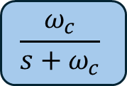

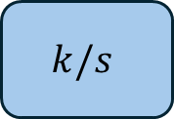
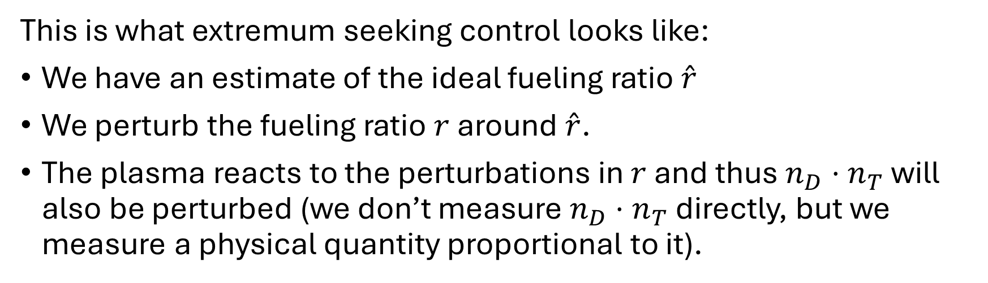





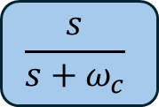
Extremum seeking control
This is what extremum seeking control looks like:
We have an estimate of the ideal fueling ratio $\hat{r}$
We perturb the fueling ratio $r$ around $\hat{r}$.
The plasma reacts to the perturbations in $r$ and thus $n_{D}⋅n_{T}$ will also be perturbed (we don’t measure $n_{D}⋅n_{T}$ directly, but we measure a physical quantity proportional to it).
$$r$$
Plasma
$$n_{D}⋅n_{T}$$
$$\frac{s}{s+ω_{c}}$$
$$a\sin{(ωt)}$$
$$\hat{r}$$
$$k/s$$
$$ξ$$
$$\frac{ω_{c}}{s+ω_{c}}$$
$$\frac{2}{a}\sin{(ωt)}$$

Slide 12
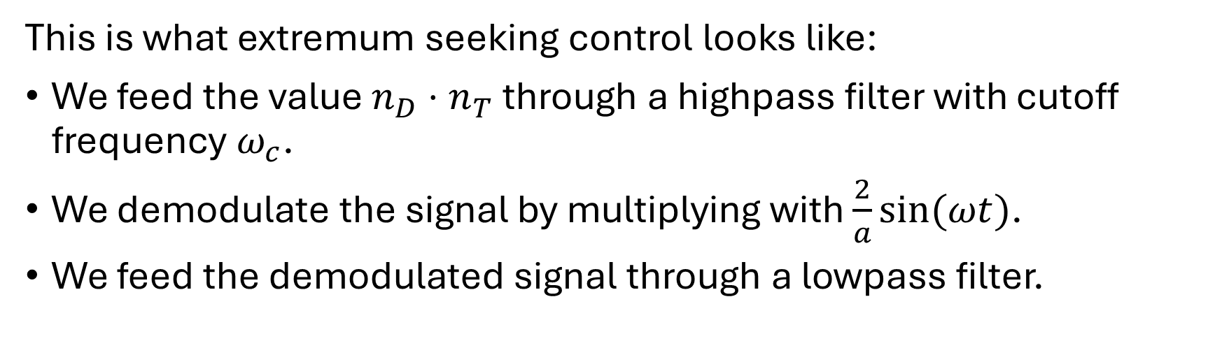
Extremum seeking control
This is what extremum seeking control looks like:
We feed the value $n_{D}⋅n_{T}$ through a highpass filter with cutoff frequency $ω_{c}$.
We demodulate the signal by multiplying with $\frac{2}{a}sin⁡(ωt)$.
We feed the demodulated signal through a lowpass filter.
$$r$$
Plasma
$$n_{D}⋅n_{T}$$
$$\frac{s}{s+ω_{c}}$$
$$a\sin{(ωt)}$$
+
$$\hat{r}$$
$$k/s$$
$$ξ$$
$$\frac{ω_{c}}{s+ω_{c}}$$
$$\frac{2}{a}\sin{(ωt)}$$
+

Slide 13
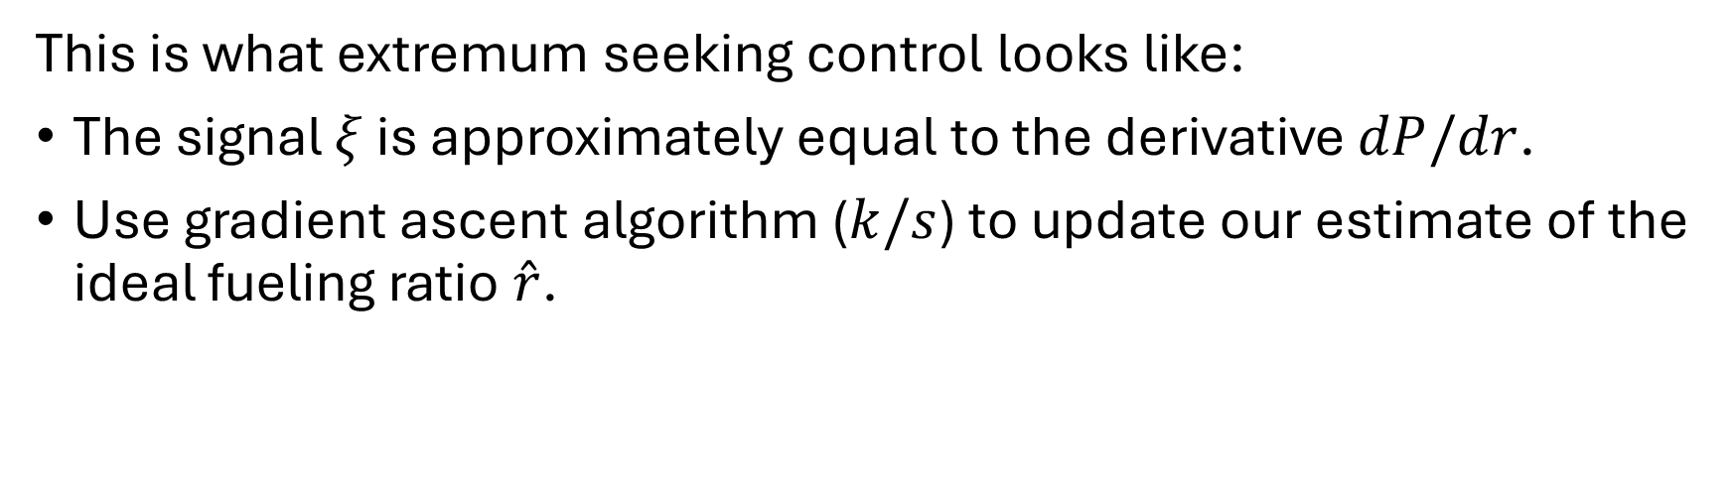
Extremum seeking control
This is what extremum seeking control looks like:
The signal $ξ$ is approximately equal to the derivative $dP/dr$.
Use gradient ascent algorithm ($k/s$) to update our estimate of the ideal fueling ratio $\hat{r}$.
$$r$$
Plasma
$$n_{D}⋅n_{T}$$
$$\frac{s}{s+ω_{c}}$$
$$a\sin{(ωt)}$$
$$\hat{r}$$
$$k/s$$
$$ξ$$
$$\frac{ω_{c}}{s+ω_{c}}$$
$$\frac{2}{a}\sin{(ωt)}$$

Slide 14
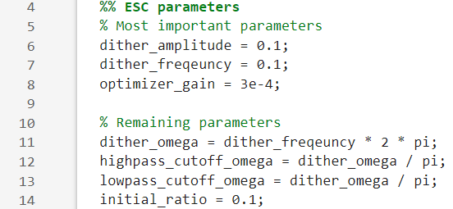
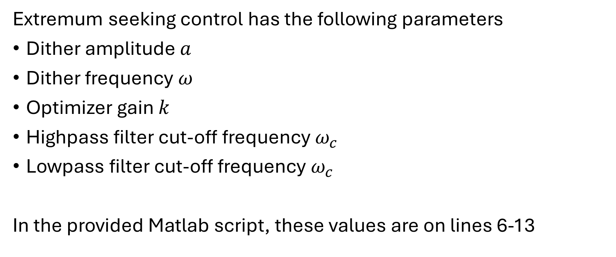
Simulation
Extremum seeking control has the following parameters
Dither amplitude $a$
Dither frequency $ω$
Optimizer gain $k$
Highpass filter cut-off frequency $ω_{c}$
Lowpass filter cut-off frequency $ω_{c}$
In the provided Matlab script, these values are on lines 6-13

Slide 15
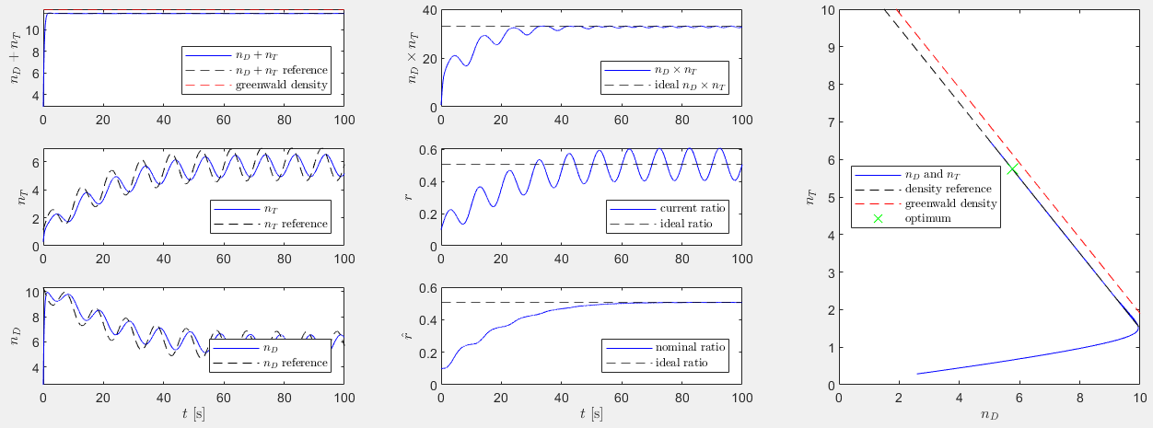
Simulation
The simulation provides the following figure

Slide 16
Simulation
The blue lines are actual values; the black dashed lines are desired values.

Slide 17

Simulation
The red dashed line is the Greenwald density limit $n_{GW}$.

Slide 18
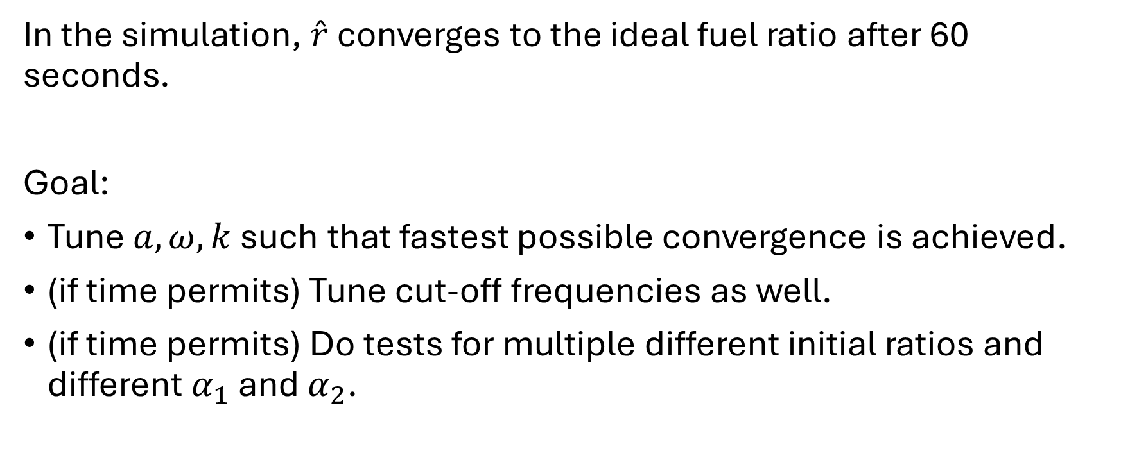
Project
In the simulation, $\hat{r}$ converges to the ideal fuel ratio after 60 seconds.
Goal:
Tune $a, ω,k$ such that fastest possible convergence is achieved.
(if time permits) Tune cut-off frequencies as well.
(if time permits) Do tests for multiple different initial ratios and different $α_{1}$ and $α_{2}$.

